Slide 1
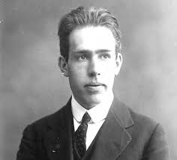
Neils Bohr
By: Tina Yetukuri

Slide 2
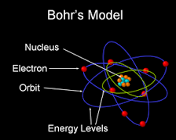
Discovery
In 1913 Neils Bohr discovered that electrons in an atom move around in orbits.
He improved Rutherford’s model.
His model was called the Bohr’s Model.
Electrons are found in energy levels.
They can never be in-between two levels.
Electrons can move from one level to another.
The number of electrons in the outer orbit determines the properties of an element.
Bohr earned a noble prize in 1922.

Slide 3
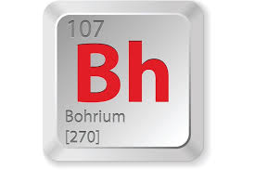
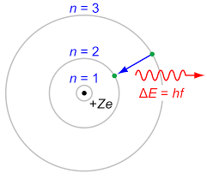
Element named after Neils Bohr.
Bohr’s hydrogen model.

Slide 4
Citations
http://www.livescience.com/32016-niels-bohr-atomic-theory.html
https://www.nobelprize.org/nobel_prizes/physics/laureates/1922/bohr-facts.html
http://abyss.uoregon.edu/~js/glossary/bohr_atom.html

